Slide 1
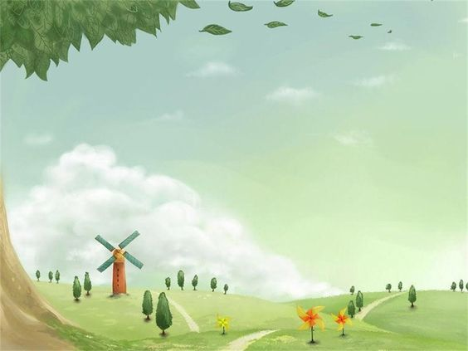



















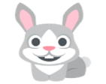


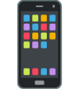


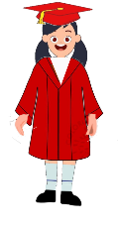




My favorite transportation is
My best friend is
My favourite music is
My favourite colour is
You are lucky
My favourite food is
My favourite teacher is
I am happy because
My favourite movie is
My favourite hobbies is
My favourite day is
My favourite sport is
You are lucky
My favourite game is
My favourite time is
My favourite place is
My dream is
I Hope
My favourite actor
My Favourite pet is
My Family
If I have money I will
My favourite animal is
My favourite game on phone is
My favourite fruit is
I want to be
My favourite car is
My favourite country is
My favourite drink is
My favourite book is
Notes:
Developed by Justin Arnold - youtube.com/thetechtrain

